Slide 1
Lab 4

Slide 2
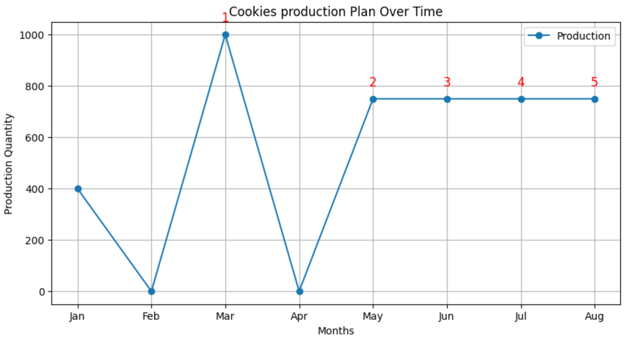
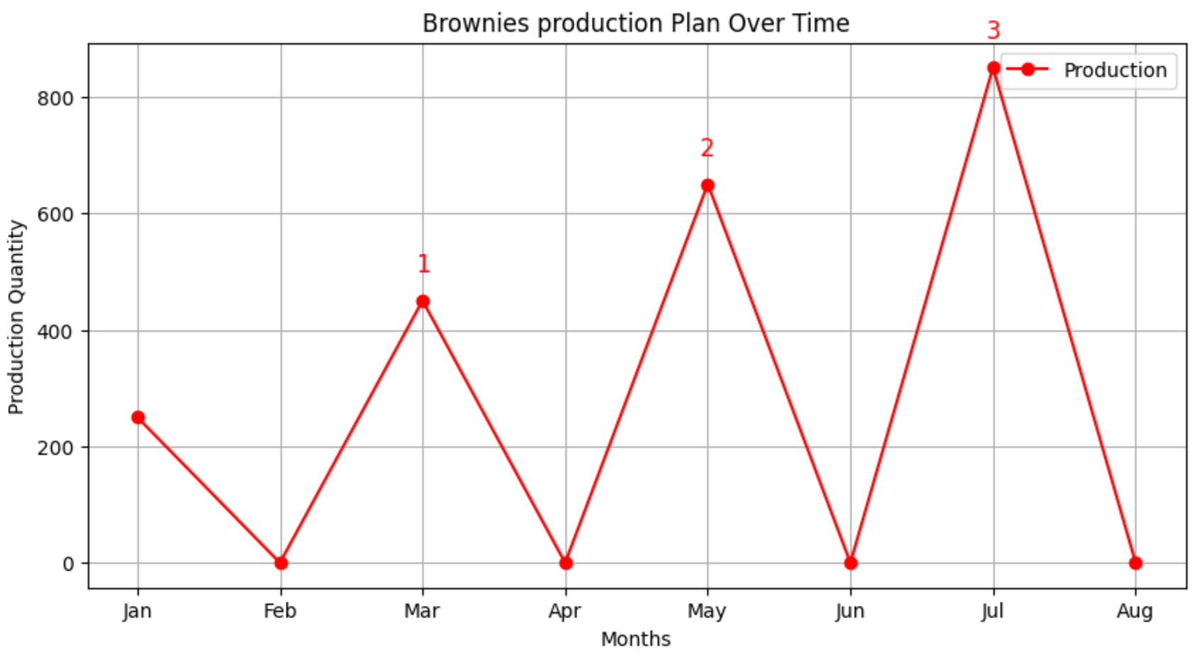
1. Independent Production Plans
- total production : 6’600 ( 4’400 cookies and 2’200 brownies) → production costs: 429’000
- Inventory costs: 7’350
- Setup costs :23’500 ( 5* 3’500 for cookies + 3 * 2’000 for brownies)
- Total costs : 459’850

Slide 3
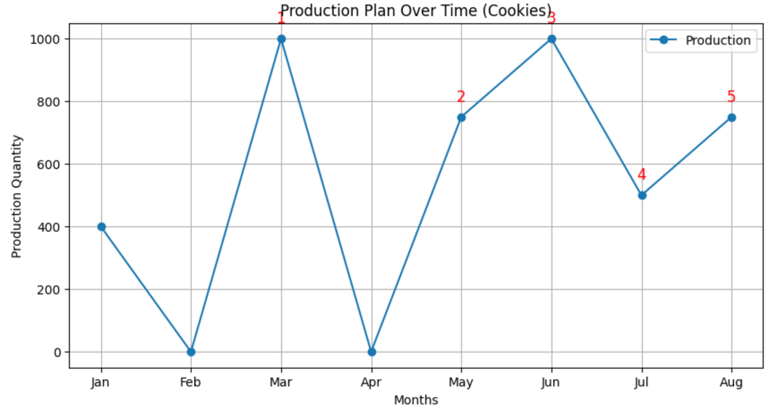
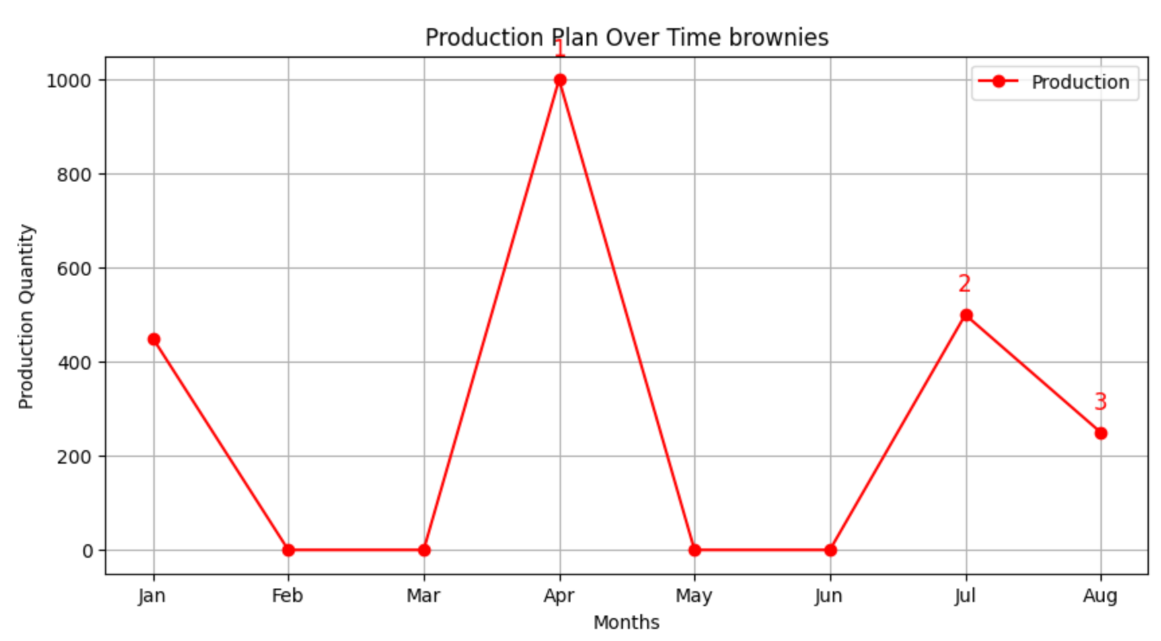
2. Joint Production Planning with capacity constraint
- total production : 6’600 ( 4’400 cookies and 2’200 brownies) → production costs: 429’000
- Inventory costs: 11’150
- Setup costs :23’500 ( 5* 3’500 for cookies + 3 * 2’000 for brownies)
- Total costs : 463’650

Slide 4
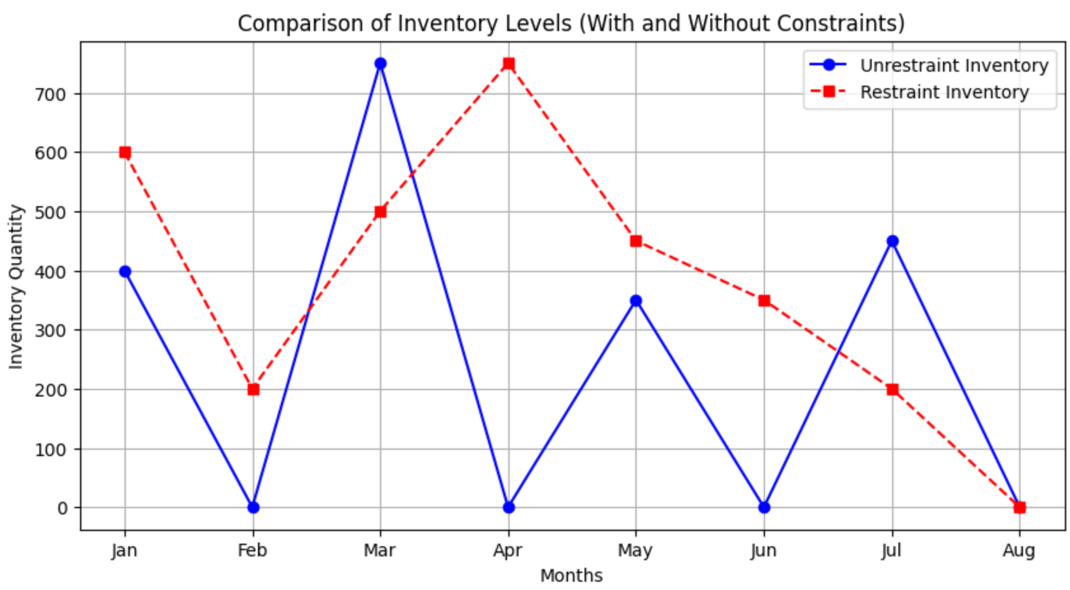
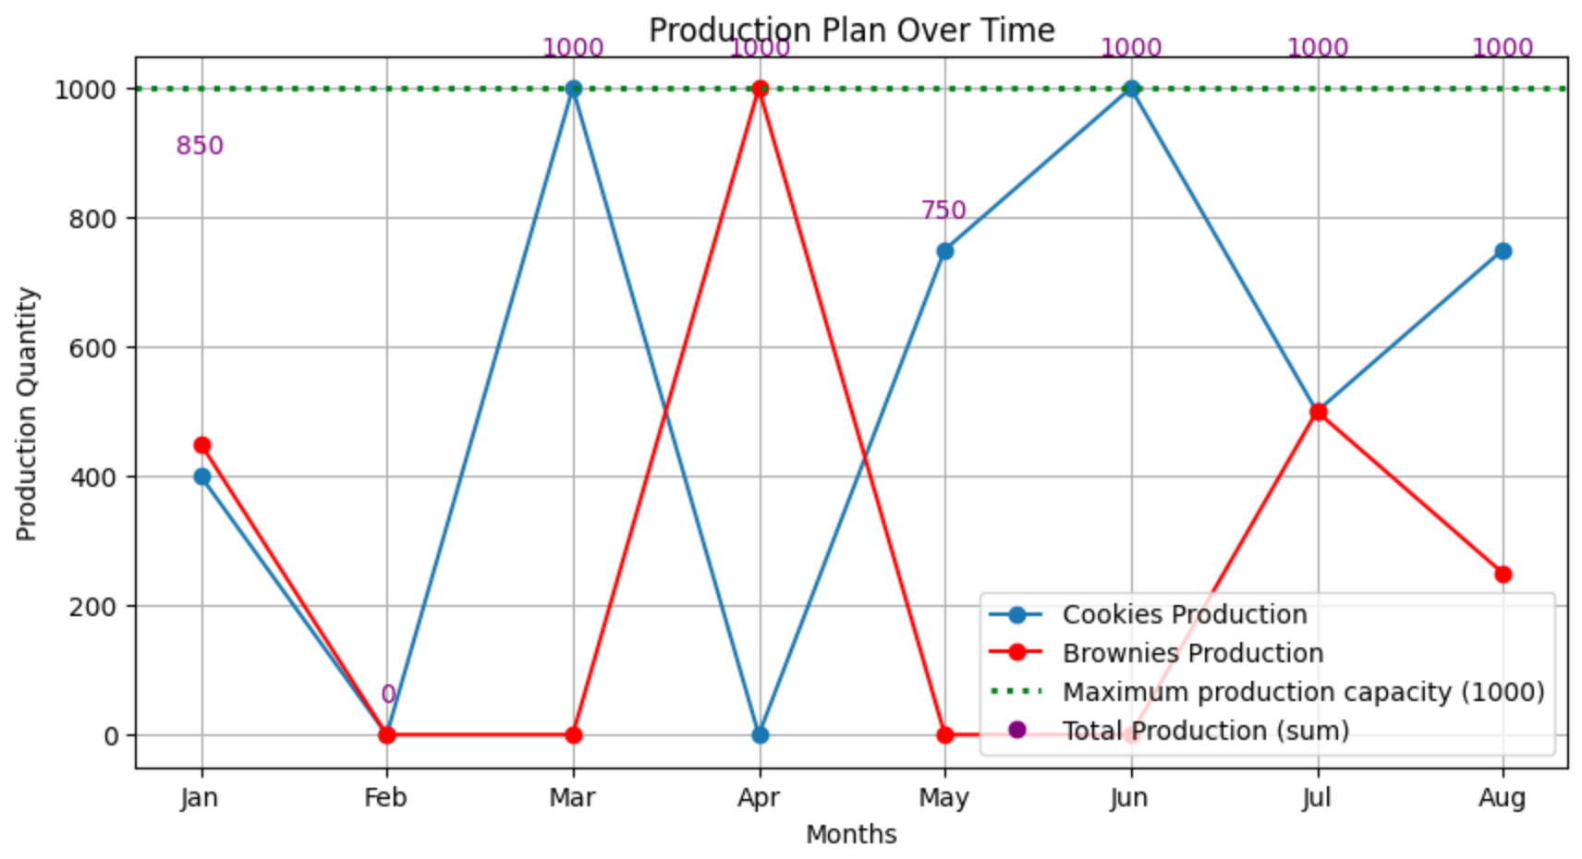
3. Capacity Restriction Impact
The maximum capacity constraint only impacts the inventory levels, when the capacity is limited th global inventory level increase..

